Slide 1

welcome

Slide 2


Hotel Reservation Analysis in SQL
Emmanuel Oladele Adetunji
Data Analysis Intern

Slide 3


Table of Contents
Introduction
Overview
Description of the Dataset
Data Cleaning
SQL Queries and Result
Conclusion
Recommendation

Slide 4
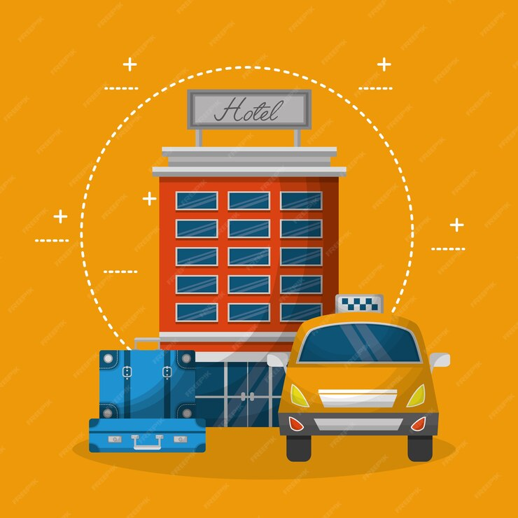
introduction
This project analyzes the "hotel reservation dataset" to uncover insights for strategic decisions, revenue optimization, and guest experience enhancement.
Leveraging the data's depth, we'll identify trends and opportunities to empower the hotel's growth and success.

Slide 5
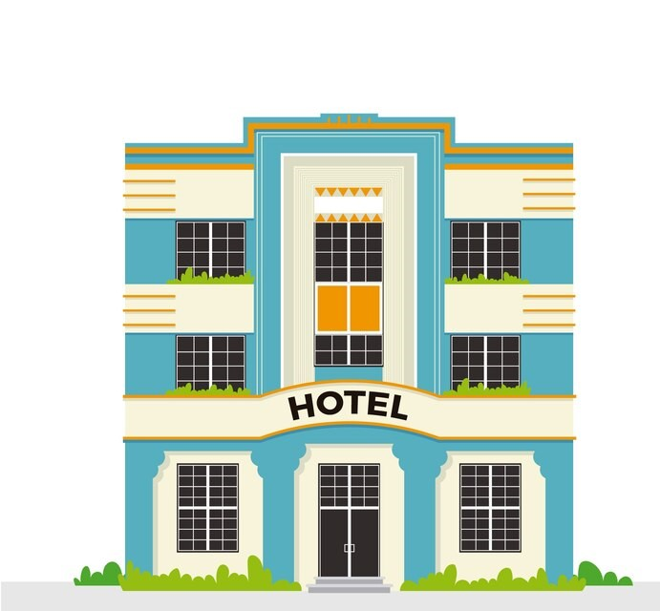
OVERVIEW
This data analysis project focuses on the "hotel reservation dataset" within the "hotels" database. The primary objective is to uncover valuable insights to inform strategic decisions, optimize revenue management, and enhance the guest experience.
Key aspects include:
Analyzing booking patterns, guest demographics, and room details.
Evaluating reservation attributes like status, requests, and deposits.
Identifying trends, patterns, and improvement opportunities.
The findings will enable the hotel management team to make data-driven decisions and drive the organization's growth and success in the hospitality industry.

Slide 6
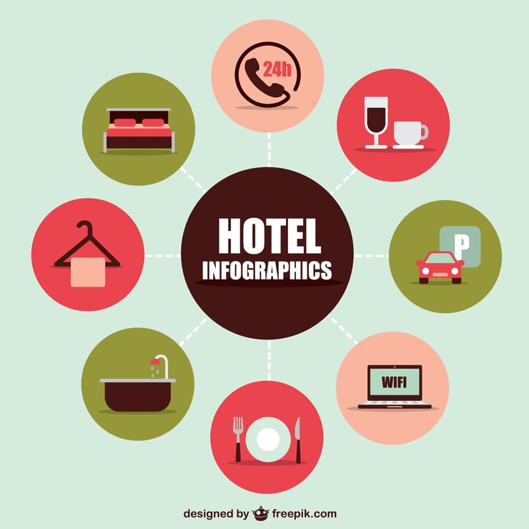
DESCRIPTION OF THE DATASET
I. Booking_ID: A unique identifier for each hotel reservation.
II. no_of_adults: The number of adults in the reservation.
IIII .no_of_children: The number of children in the reservation.
IV. no_of_weekend_nights: The number of nights in the reservation that fall on weekends.
V. no_of_week_nights: The number of nights in the reservation that fall on weekdays.
VI. type_of_meal_plan: The meal plan chosen by the guests.
VII. room_type_reserved: The type of room reserved by the guests.
VIII. lead_time: The number of days between booking and arrival.
IX .arrival_date: The date of arrival.
X. market_segment_type: The market segment to which the reservation belongs.
XI. avg_price_per_room: The average price per room in the reservation.
XII. booking_status: The status of the booking.

Slide 7

DATA CLEANING AND ANALYSIS

Slide 8
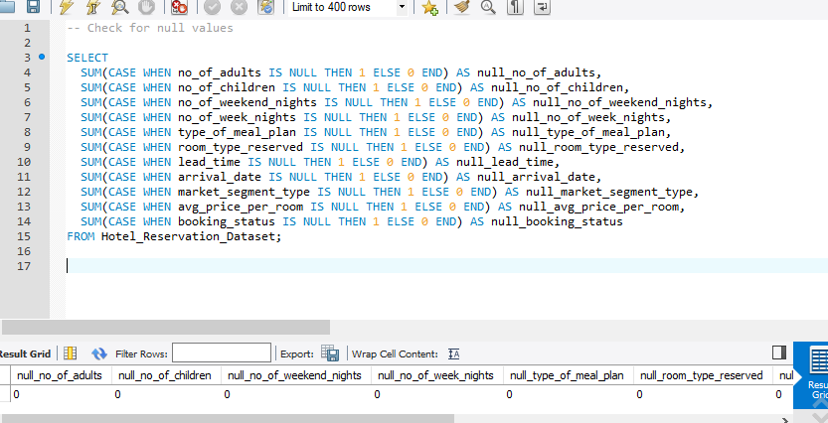
Check for missing value
No missing Value found

Slide 9
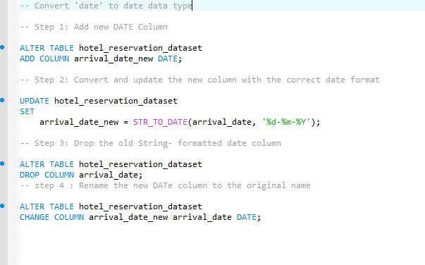
2. Convert ‘date’ to date data type
This query will enable the change of the date column from text to date data type which will be beneficiary in the long run of this analysis

Slide 10

SQL Queries and their Result

Slide 11
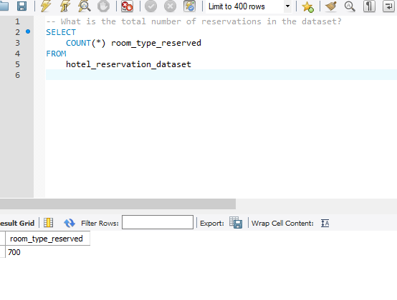
1. Total number of reservation
There are over 700 numbers of reservations

Slide 12
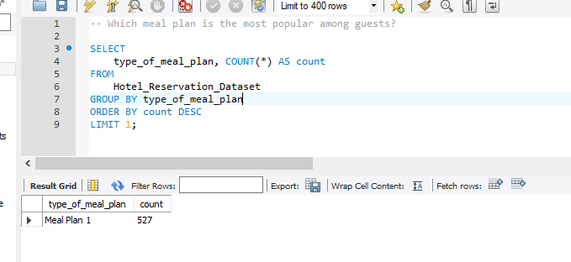
2. The most popular meal plan among the guest
Meal 1 was the most popular meal plan with a count of 527

Slide 13
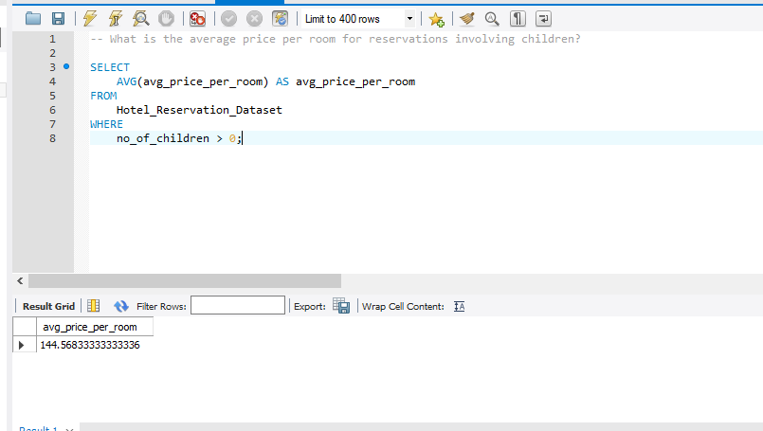

3. the average price per room for reservations involving children
The average price per room for children is approximately 145

Slide 14
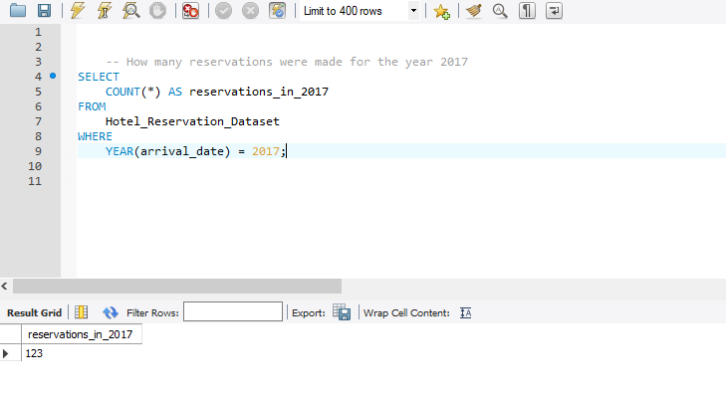

4. Number of reservations that were made for the year 2017.
123 reservations were made in 2017

Slide 15
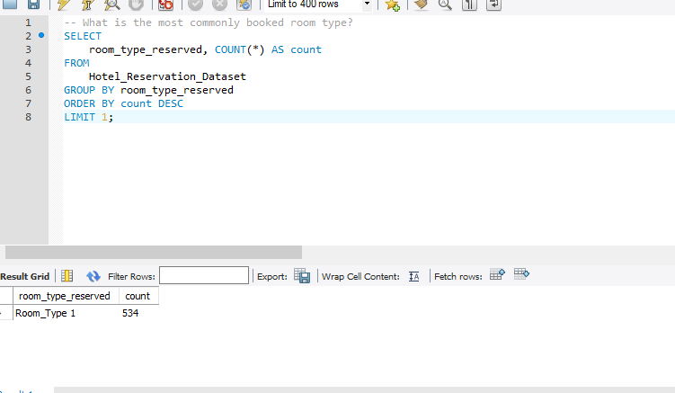
5.the most commonly booked room type
Room type 1 is the most commonly booked room with a total number of 534

Slide 16
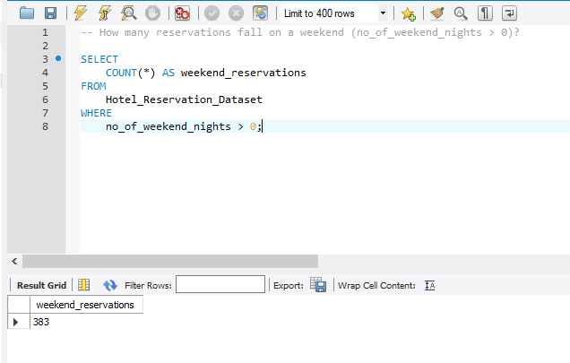
6.The total number of reservations that fall on a weekend (no_of_weekend_nights > 0)
The total number of reservation on weekend night were 383

Slide 17
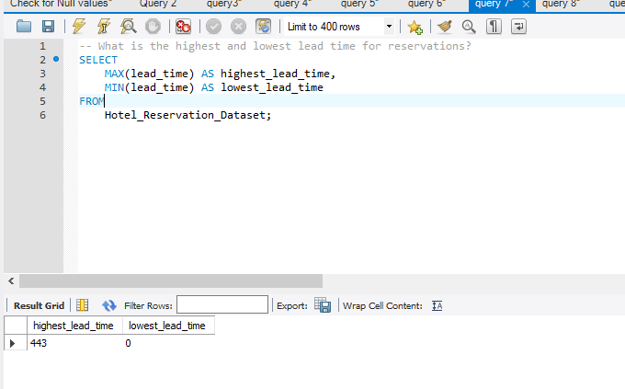
7. the highest and lowest lead time foR reservations
The highest time of lead was 443 and the lowest time of lead was 0

Slide 18
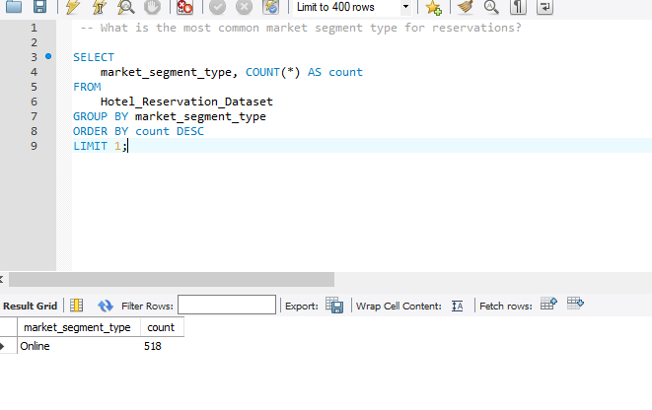
8.the most common market segment type for reservations
Online segment type was the most common market segment for reservation

Slide 19
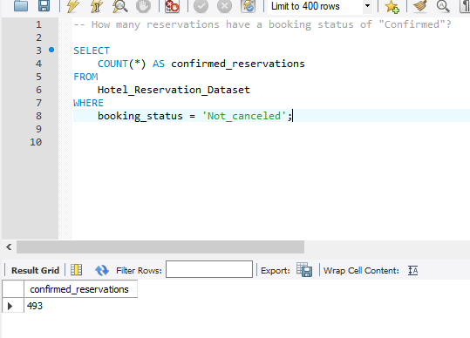
9. The number of reservations have a booking status of "Confirmed”
493 reservation were having the status not canceled which simply means “confirmed”

Slide 20
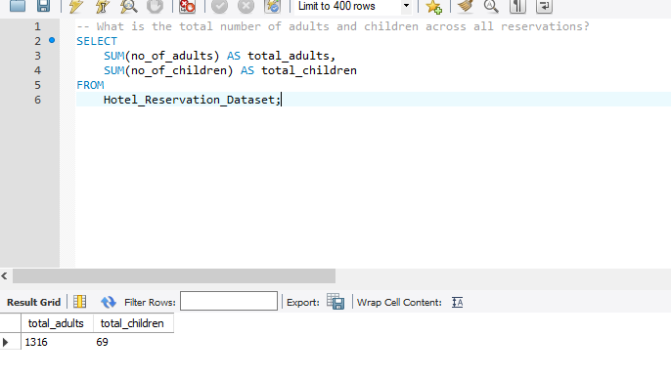
10. the total number of adults and children across all reservations
1316 were the total number of reservation for adult while 69 reservation were for children

Slide 21
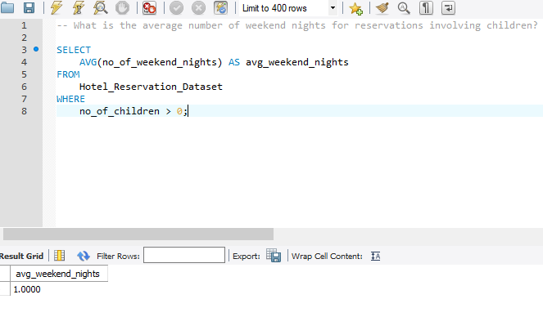
11. the average number of weekend nights for reservations involving children?
1.0 is the average number of weekend night for reservation involving children

Slide 22
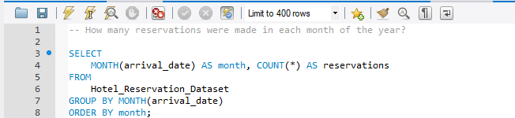
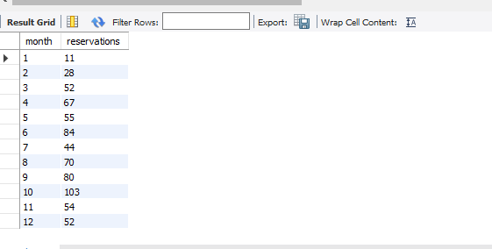
12. Total number of reservations made in each month of the year
The result shows the number of reservation for each month of the year

Slide 23
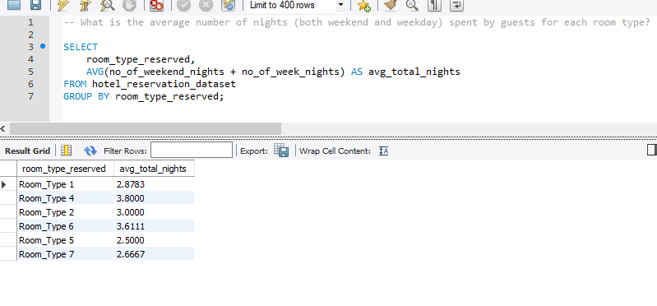
13. the average number of nights (both weekend and weekday) spent by guests for each room type.
The result shows the average number of reservation for both weekend and weekdays night for each room

Slide 24
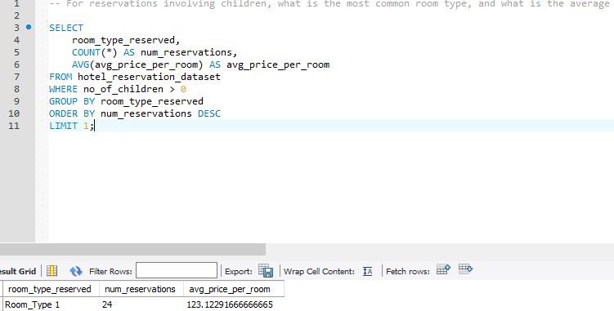
14. reservations involving children, what is the most common room type, and what is the average
Room type 1 has the highest number of room for children

Slide 25
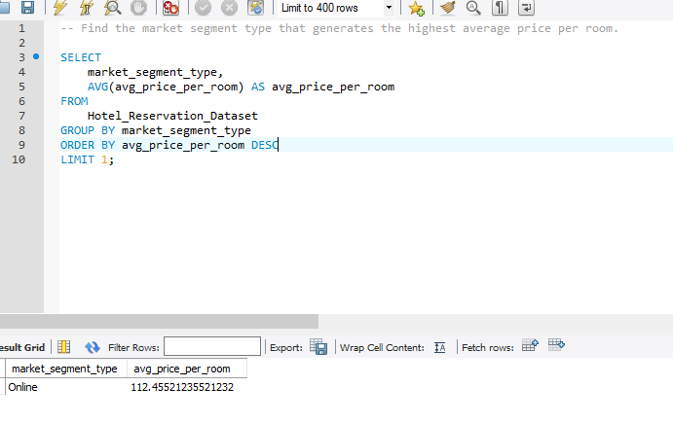
15. the market segment type that generates the highest average price per room.
Online market segment has the average price per room of approximately 112.45

Slide 26

Conclusion
This data analysis project has equipped us with a robust set of insights that can be leveraged to drive strategic and operational improvements within the hotel. By delving into the nuances of the hotel reservation dataset, we have uncovered a treasure trove of information that can be transformed into tangible business value.
The key takeaways from this exercise, such as the identification of the most profitable room types, the optimal timing for marketing campaigns, and the customer segments with the highest lifetime value, provide a clear roadmap for enhancing the hotel's competitiveness and profitability. Armed with these insights, the hotel management team can make data-driven decisions, refine their pricing strategies, and tailor the
Guest experience to meet the evolving needs of their clientele.
As we move forward, the implementation of the recommended strategies will be crucial in solidifying the hotel's position as a market leader. By continuously monitoring the data and adapting to changing market dynamics, the hotel can maintain a competitive edge, drive sustainable growth, and cement its reputation as a premier destination for discerning travelers.

Slide 27

Recommendation
Based on the analysis of the hotel reservation data, we recommend the following strategic actions:
I. Optimize Room Pricing and Inventory Management:
Adjust pricing strategies and implement dynamic pricing models to capitalize on demand fluctuations.
Enhance room inventory management to align with evolving guest preferences.
ii. Enhance the Guest Experience:
Target high-value guest segments through personalized marketing and loyalty programs.
Improve Revenue Management Strategies:
Optimize inventory allocation and pricing for high-demand periods.
iii. Enhance Data-Driven Decision-Making:
Establish a centralized data management system to facilitate ongoing analysis.
Analyze the average price per room for reservations involving children to identify opportunities for targeted family-friendly offerings and packages. Explore ways to enhance the guest experience for families, such as specialized amenities and activities, to encourage repeat bookings and referrals.
By implementing these recommendations, the hotel can unlock growth opportunities, optimize revenue, and elevate the guest experience, positioning itself as an industry leader.

Slide 28

Thank you

